Slide 1
Knowledge Graph–Driven Explainable AI Framework for End-to-End Healthcare Insurance Automation: A US–India Comparative Perspective
Name :Kuhan K
Roll No :2024MCS110028
Project Guide :Dr. Sreeja m. u.
Date of Review : 21st February 2026

Slide 2
Supervisor Approval

Slide 3
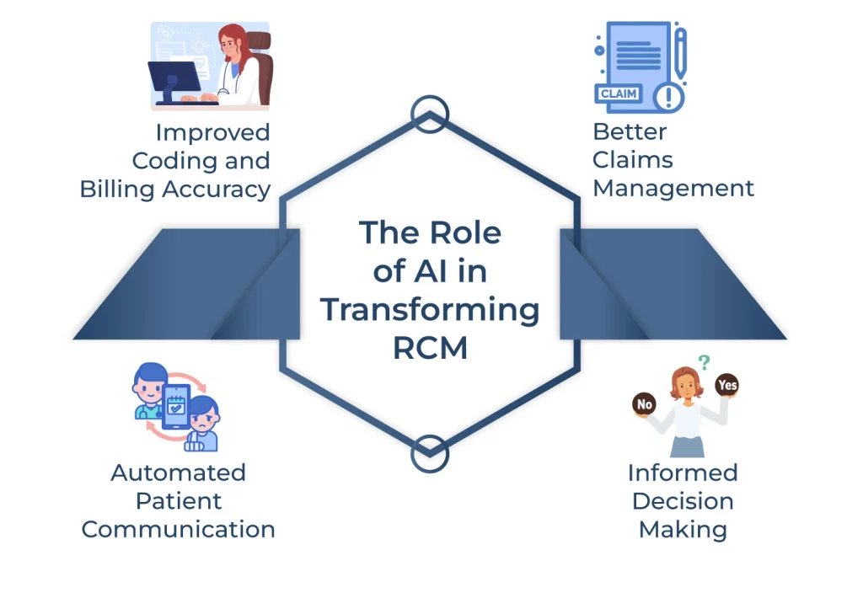
CONTENTS
Introduction
Healthcare Insurance Workflow (US & India)
Problem Statement
Literature Review & Research Gap
Objectives
Proposed End-to-End Architecture
Methodology
Feasibility Study
Expected Outcomes
Innovation & Contribution
Project Plan
Summary

Slide 4
INTRODUCTION
Healthcare insurance processing is fragmented and policy-driven
US ecosystem involves private insurers and complex medical necessity rules
Indian ecosystem relies on TPAs (Third Party Administrator) and cashless authorization models
Decisions depend on static rule engines and manual review
High denial rates and administrative burden persist
Need for intelligent, explainable end-to-end automation
Healthcare insurance processing involves multiple stages from eligibility to final reimbursement. Both US and Indian systems rely heavily on manual reviews and static rule engines. This results in delays, inconsistent decisions, and lack of transparency. Therefore, there is a need for an integrated, explainable AI framework that can automate the entire insurance workflow.

Slide 5
LITERATURE REVIEW - Summary
Ref | Model / Approach Used | Used For | Final Goal | Limitation | Gap Addressed
Chaturvedi et al. (2025) | Gradient Boosting / ML classifiers | Claim denial prediction | Reduce denial rates | No explainability layer | No KG reasoning or full workflow automation
Mello (2026) | AI-driven utilization review analysis | Policy automation discussion | Improve efficiency in payer review | Conceptual, not technical architecture | No integrated ML + KG framework
Rajabi (2022) | Knowledge Graph + XAI | Explainable healthcare AI | Improve interpretability | Generic healthcare use | Not insurance-specific
Rajabi (2024 Survey) | Systematic review of KG-XAI | Survey of XAI methods | Categorize explainable AI systems | No practical implementation | No insurance workflow application
Gao et al. (2025) | Knowledge Graph + LLM | Clinical diagnosis prediction | Improve medical reasoning accuracy | Clinical focus only | No payer or denial prediction context
Noor (2025) | Explainable AI techniques | Healthcare interpretability | Improve model transparency | Theoretical overview | No workflow automation
Intelligent Claims Mgmt (2025) | AI + RPA automation | Claims processing optimization | Speed up claim handling | No predictive modeling depth | No explainable AI integration
Denial Market Study (2025) | Predictive analytics overview | Denial trend analysis | Reduce revenue loss | Industry-level, not model-focused | No technical implementation

Slide 6
LITERATURE REVIEW - Existing Approach
Rule-Based Insurance Systems
Static policy engines for eligibility & authorization
Deterministic decision logic
Limited adaptability
No probabilistic risk estimation
Machine Learning in Claims Analytics
Denial prediction models
Fraud detection systems
Risk scoring using structured claim data
Often black-box models
AI in Utilization Management (US)
Medical necessity validation
Prior authorization optimization
Workflow automation tools
Healthcare Knowledge Graphs
Modeling clinical relationships
Drug–disease interaction graphs
Policy and guideline representation

Slide 7
LITERATURE REVIEW -Research Gaps
Identified Gaps
Most systems automate only one stage (e.g., denial prediction)
Limited integration across end-to-end workflow
Rule engines lack learning capability
ML models lack explainability
Minimal cross-ecosystem (US–India) comparison

Slide 8
LITERATURE REVIEW –Research Opportunity
Develop a unified framework that:
Combines knowledge graph reasoning
Integrates ML probability prediction
Provides explainable decisions
Automates end-to-end insurance workflow
Existing systems either use rule-based engines or machine learning models independently. However, rule engines cannot adapt, and ML models lack transparency. Moreover, automation efforts are limited to individual stages like denial prediction. There is no unified, explainable framework integrating policy reasoning and probabilistic prediction across the entire insurance workflow.

Slide 9
Research Papers
Recent Research (2025–2026)
Mello (2026): AI risks & opportunities in US utilization review
Escobar (2025): Knowledge graph–based explainable AI frameworks
Gao et al. (2025): Integrating knowledge graphs with LLMs for clinical reasoning
These studies highlight:
Growing AI adoption in insurance workflows
Importance of explainability
Role of knowledge graphs in structured reasoning

Slide 10
Research Papers
Chaturvedi et al. (2025) – Claim Denial Prediction
Proposes machine learning models to predict healthcare claim denials and reduce revenue loss through early risk identification.
Rajabi (2022) – Knowledge Graphs & XAI
Explores how knowledge graphs enhance explainability in healthcare AI systems by structuring domain relationships
Rajabi (2024) – KG-Based Explainable AI Review
Provides a systematic review of knowledge-graph-based explainable AI methods and their integration with machine learning models.

Slide 11
Research Papers
Intelligent Insurance Claims Management (2025)
Reviews AI and automation techniques for improving efficiency in insurance claim processing workflows.
AI-Powered Claim Denial Market Study (2025)
Discusses emerging trends and market growth of AI-driven denial management solutions in healthcare revenue cycle systems.
Noor (2025) – XAI in Healthcare
Surveys recent advancements in explainable AI methods and their importance in healthcare decision-support systems.

Slide 12
PROBLEM STATEMENT – Core Problem
The core problem is the absence of an integrated, explainable AI framework that can model policy logic, predict decision outcomes, and provide transparent reasoning across the entire healthcare insurance workflow.

Slide 13
PROBLEM STATEMENT
Insurance decisions depend on static rule engines and manual review
High denial rates and administrative burden persist
Lack of probabilistic approval prediction
Limited explainability for compliance and audit
No integrated framework covering full workflow lifecycle
Growing need for transparent AI-driven automation
Current healthcare insurance workflows in both US and Indian ecosystems operate in silos. Most systems rely on rigid rule engines or manual verification processes. Even where machine learning is used, models often lack transparency. There is no unified, explainable framework that automates the complete insurance lifecycle from eligibility to claim adjudication. This creates delays, denials, and operational inefficiencies.

Slide 14
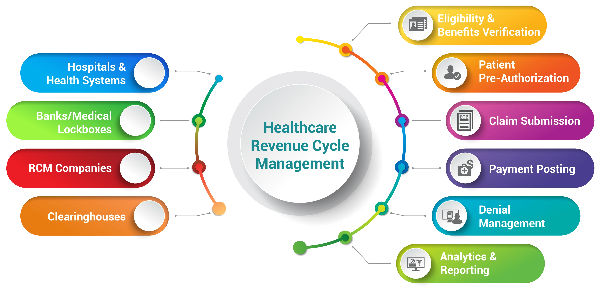
US Healthcare Process Diagram

Slide 15
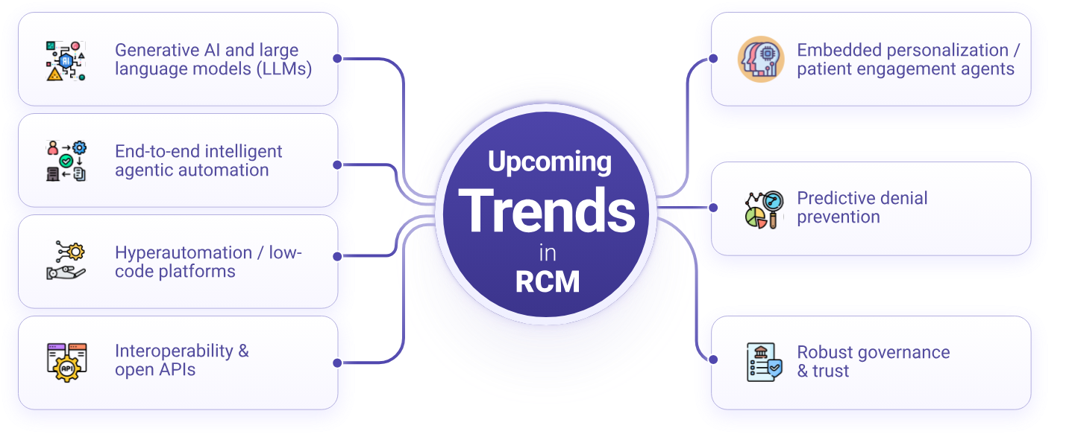
Trends In RCM

Slide 16
FEASIBILITY STUDY – Overview
De-identified healthcare and insurance datasets are available for research purposes. The proposed system can be implemented using machine learning models and knowledge graph frameworks, with LLM support. The architecture is modular and adaptable across US and Indian insurance ecosystems.

Slide 17
FEASIBILITY STUDY – Technical Feasibility
Domain access to healthcare datasets (claims & patient records – de-identified)
Availability of historical insurance workflow data
Public datasets (genomic repositories, policy documentation samples)
ML models for pattern recognition (XGBoost / Random Forest)
LLM support via Hugging Face APIs for rule extraction & reasoning
Knowledge graph implementation using Neo4j

Slide 18
FEASIBILITY STUDY – Operational Feasibility
Modular design adaptable to US payer systems
Can be extended to Indian TPA-based cashless workflows
Example: US medical necessity rules → mapped to Indian policy exclusion clauses
Deployable as decision-support layer over existing HIS / RCM systems

Slide 19
FEASIBILITY STUDY – Economic and Regulatory Feasibility
Reduces denial rate & administrative overhead
Improves reimbursement predictability
Explainable outputs for HIPAA (US) and IRDAI (India) compliance

Slide 20
OBJECTIVES
To design an integrated, explainable AI framework that combines knowledge graph reasoning and machine learning to automate healthcare insurance workflows with transparent, audit-ready decision support
Construct policy–procedure–diagnosis knowledge graph
Train ML models for risk and coverage prediction
Implement SHAP-based explainability to interpret model predictions and identify feature contributions
Build modular end-to-end automation pipeline
Validate using Accuracy, F1-score, ROC-AUC, Calibration curve, SHAP-based explanation consistency
Demonstrate cross-ecosystem adaptability (- Demonstrate US–India adaptability)
*SHAP = Shapley Additive explanations

Slide 21
EXPECTED OUTCOME
The expected outcome is a unified, explainable AI framework capable of predicting insurance approval or denial probabilities while providing transparent reasoning. The system will improve workflow efficiency and demonstrate adaptability across both US and Indian healthcare insurance ecosystems.
Predictive model with validated classification performance
Calibrated probability outputs for risk estimation
Transparent reasoning path via knowledge graph
Reduced denial risk through early detection
Modular retraining capability
Prototype decision-support system

Slide 22
PROPOSED METHODOLOGY
The methodology begins with structured healthcare and insurance data preprocessing. A knowledge graph is constructed to model policy relationships. A supervised ML model is trained to predict approval probability. SHAP is used to generate explainable outputs. Finally, the system is evaluated using classification and calibration metrics.

Slide 23
PROPOSED METHODOLOGY - System Pipeline
Step 1: Data Collection
De-identified patient & claims data
ICD / CPT codes
Insurance policy details
Historical approval / denial outcomes
Step 2: Data Preprocessing
Data cleaning & normalization
Feature encoding
Missing value handling
Feature engineering
Step 3: Knowledge Graph Construction
Nodes: Patient, Diagnosis, Procedure, Policy
Edges: Covered_By, Requires_Auth, Excluded_For
Policy-rule modeling

Slide 24
PROPOSED METHODOLOGY – AI & Evaluation
Step 4: ML Model Development
Supervised classification model
Algorithms: XGBoost / Random Forest
Output: Approval / Denial probability
Step 5: Explainability Layer
SHAP value computation
Feature contribution analysis
Graph-based reasoning path
Step 6: Model Evaluation
Accuracy, F1-score, ROC-AUC
Calibration score
Validation using test dataset

Slide 25
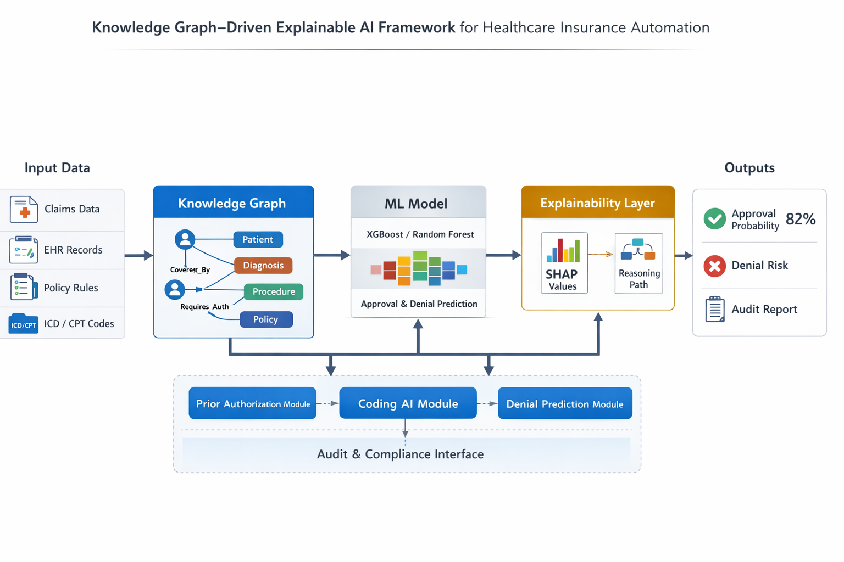
PROPOSED METHODOLOGY – Architecture

Slide 26
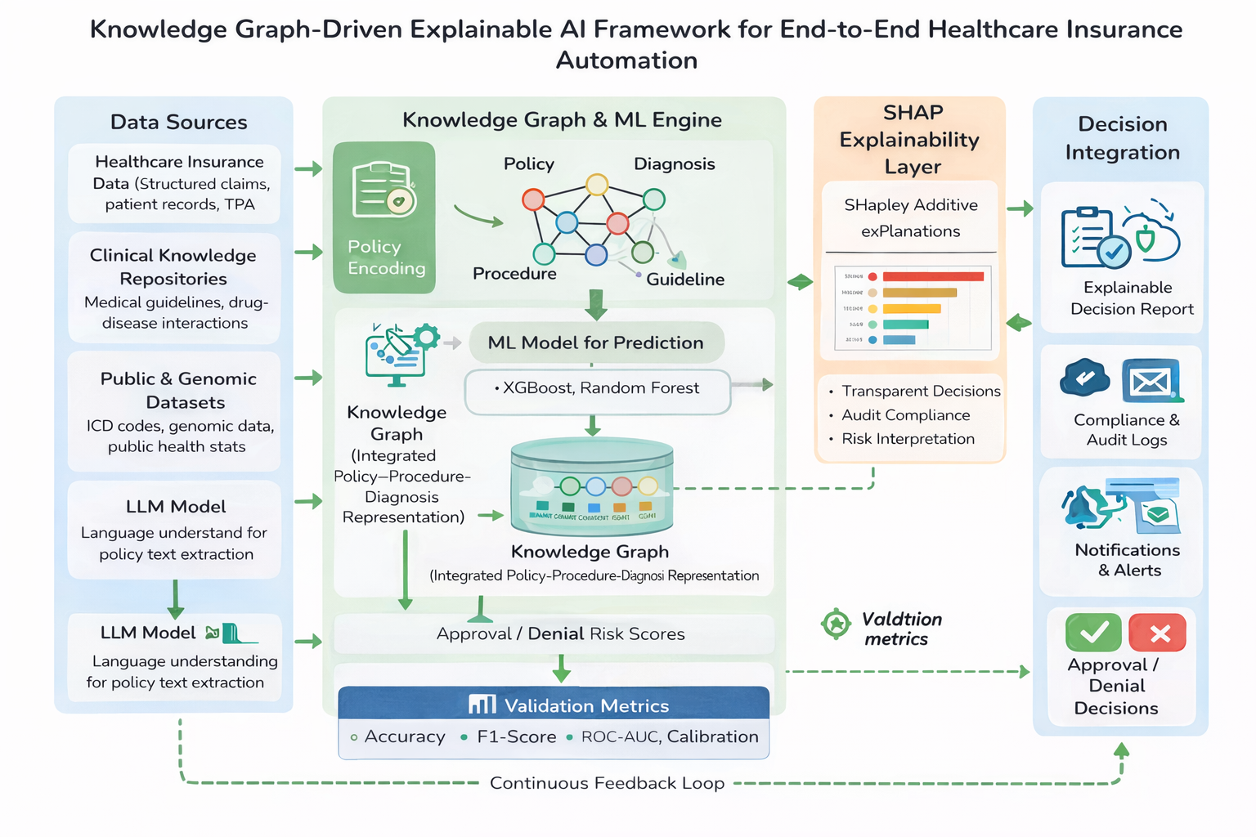

Slide 27
PROJECT PLAN
Phase I – Research & Core System Design
Stage 1 – Proposal & Design (Review 1)
Literature survey (KG + XAI + Insurance AI)
Problem definition
End-to-end architecture design
Module definition:
Prior Authorization AI
Denial Prediction AI
Coding AI
Feasibility study

Slide 28
PROJECT PLAN
Stage 2 – Data Engineering & Knowledge Modeling (Interim Review)
Data collection (de-identified claims, EHR)
Policy document analysis
Feature engineering
Knowledge graph schema design
ICD–CPT–Policy relationship modeling

Slide 29
PROJECT PLAN
Stage 3 – Initial Model Development (Final Review – Phase I)
Prior Authorization ML prototype
Denial prediction baseline model
Coding AI initial classifier
Initial validation metrics
Preliminary results documentation

Slide 30
PROJECT PLAN
Phase II – Advanced AI Development & Integration
Stage 4 – Model Optimization & Explainability
Hyperparameter tuning
Stage 5 – End-to-End Integration
Connect KG + ML + Coding AI
Build workflow engine
Stage 6 – System Evaluation & Comparative Study
Performance benchmarking
US vs India workflow mapping
Stage 7 – Prototype & Documentation
Web-based decision support interface
Dashboard visualization
Thesis writing
Final presentation preparation

Slide 31
SUMMARY
In summary, this project proposes a unified, explainable AI framework that automates the end-to-end healthcare insurance workflow. By integrating knowledge graph reasoning, machine learning prediction, and explainable AI, the system addresses inefficiencies in prior authorization, denial prediction, and coding validation. The architecture is modular and adaptable to both US and Indian healthcare ecosystems.
Identified inefficiencies in insurance automation
Designed modular AI-driven workflow architecture
Combined symbolic reasoning (KG) with statistical learning (ML)
Integrated explainable AI for audit compliance
Supports multi-stage insurance lifecycle
Demonstrates research and industrial relevance

Slide 32
REFERENCES
The references include recent studies on AI in utilization review, knowledge graph–based explainable AI frameworks, and SHAP-based interpretability methods, which directly support the proposed architecture.
AI in utilization review / coverage decisions (2026)
Analyzes the growing use of AI in US insurance utilization review, highlighting efficiency gains and potential regulatory risks.
AI in Utilization Review / Insurance Decisions (US)
M. M. Mello, “The AI Arms Race In Health Insurance Utilization Review: Promises Of Efficiency And Risks Of Supercharged Flaws” Health Affairs, 2026
https://www.healthaffairs.org/doi/10.1377/hlthaff.2025.00897
KG + LLM for clinical reasoning (2025)
Diagnostic Reasoning with Knowledge Graphs & LLMs
Y. Gao et al., “Leveraging Medical Knowledge Graphs Into Large Language Models for Diagnosis Prediction,” JMIR AI, 2025.
Available: https://ai.jmir.org/2025/1/e58670
Demonstrates integration of medical knowledge graphs with large language models to improve diagnostic reasoning accuracy.

Slide 33
REFERENCES
Knowledge + explainability (2025)
R. A. del Águila Escobar, “Bridging Text and Knowledge: Explainable AI for Knowledge Graph Classification and Concept Map-Based Semantic Domain Discovery with OBOE Framework” Applied Sciences, vol. 15, no. 22, 2025.
https://www.mdpi.com/2076-3417/15/22/12231
Healthcare Claim Denial Prediction with ML
R. Chaturvedi et al., “Leveraging Machine Learning to Predict and Reduce Healthcare Claim Denials,” 2025.
Proposes machine learning models to predict healthcare claim denials and reduce revenue loss through early risk identification.
https://www.researchgate.net/publication/388836543_LEVERAGING_MACHINE_LEARNING_TO_PREDICT_AND_REDUCE_HEALTHCARE_CLAIM_DENIALS

Slide 34
REFERENCES
Knowledge Graphs & Explainable AI in Healthcare
E. Rajabi, “Knowledge Graphs and Explainable AI in Healthcare,” Information, 2022.
Available: https://www.mdpi.com/2078-2489/13/10/459
Systematic Review of Knowledge-Graph-Based XAI
E. Rajabi, “Knowledge-graph-based Explainable AI: A Systematic Review,” J. Information Science, 2024.
Available: https://journals.sagepub.com/doi/10.1177/01655515221112844
Review of AI + Automation in Insurance Claims Mgmt
“Intelligent Insurance Claims Management through AI and Automation,” 2025.
Available: https://drpress.org/ojs/index.php/mmaa/article/download/32151/31473

Slide 35
REFERENCES
AI-Powered Claim Denial Market & Trends
“AI-Powered Claim Denial Management Market Overview,” 2025 (industry & tech trends).
Available: https://towardshealthcare.com/insights/ai-powered-claim-denial-management-market-sizing
Explainable AI in Healthcare Trends
A. A. Noor, “Unveiling Explainable AI in Healthcare: Current Trends,” WIREs Data Mining and Knowledge Discovery, 2025.
Available: https://wires.onlinelibrary.wiley.com/doi/full/10.1002/widm.70018

